Slide 1
The Data Warehouse Toolkit
By Ralph Kimball
Chapter 2: Retail Sales
Prepared by: Song Nguyen
02/24/2019

Slide 2
2.0 Introduction
Four-step process for designing dimensional models
Transaction-level fact tables
Additive and non-additive facts
Sample dimension table attributes
Causal dimensions, such as promotion
Degenerate dimensions, such as the transaction ticket number
Extending an existing dimension model
Snowflaking dimension attributes
Avoiding the “too many dimensions” trap
Surrogate keys
Market basket analysis

Slide 3
2.1 Four-Step Dimensional Design Process
1. Select the business process to model.
2. Declare the grain of the business process.
3. Choose the dimensions that apply to each fact table row.
4. Identify the numeric facts that will populate each fact table row.

Slide 4
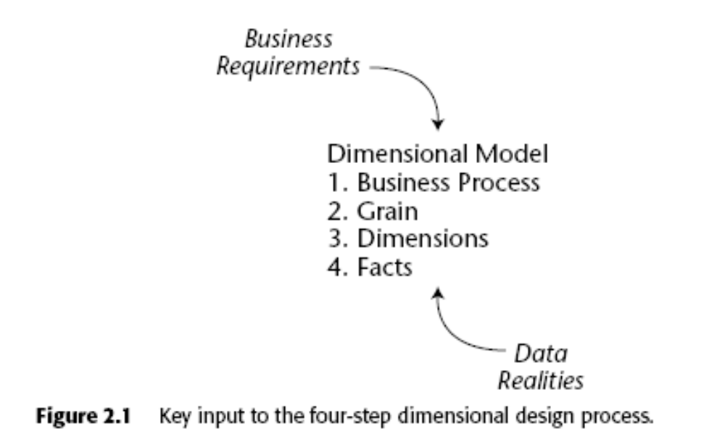
2.2 Retail Case Study
Notes:
- Our business has 100 grocery stores spread over a five-state area.
Each of the stores has a full complement of departments, including grocery, frozen foods, dairy, meat, produce, bakery, floral, and health/beauty aids. (60,000 products)
About 55,000 of the SKUs come from outside manufacturers and have bar codes imprinted on the product package.
About 55,000 of the SKUs come from outside manufacturers and have bar codes imprinted on the product package
The remaining 5,000 SKUs come from departments such as meat, produce, bakery, or floral.
At the grocery store, management is concerned with the logistics of ordering, stocking, and selling products while maximizing profit.

Slide 5
2.2.1 Step 1. Select the Business Process
The first step in the design is to combine an understanding of the business requirements with an understanding of the available data.
We’d build a single dimensional model to avoid ETL redundancy.
Note: The first dimensional model should answer the most pressing business questions and be readily accessible for data extraction.

Slide 6
2.2.2 Step 2. Declare the Grain
Atomic data provides maximum analytic flexibility because it can be constrained and rolled up in every way possible.
Example grain declarations include:
  An individual line item on a customer’s retail sales ticket as measured by a scanner device
  An individual boarding pass to get on a flight
  A daily snapshot of the inventory levels for each product in a warehouse or, daily snapshots of impressions for partner/publisher on portal grainuarlity (Ys, Ns …etc)
  A monthly snapshot for each bank account

Slide 7
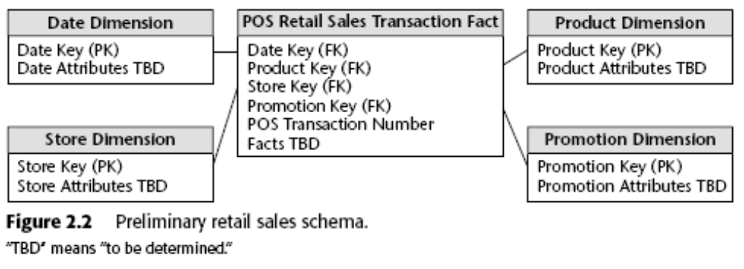
2.2.3 Step 3. Choose the Dimensions
Once the grain of the fact table has been chosen, the date, product, and store dimensions fall out immediately. Fact grain statement should accommodate additional dims. (TBD = To Be Decided)

Slide 8
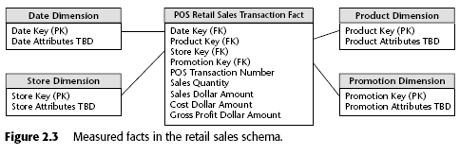
2.2.4 Step 4. Identify the Facts
The fourth and final step in the design is to make a careful determination of which facts will appear in the fact table.

Slide 9
2.3 Dimension Table Attributes
Now that we’ve walked through the four-step process, let’s return to the dimension tables and focus on filling them with robust attributes.
Percentages and ratios, such as gross margin, are non-additive. The numerator and denominator should be stored in the fact table. The ratio can be calculated in a data access tool for any slice of the fact table by remembering to calculate the ratio of the sums, not the sum of the ratios.

Slide 10
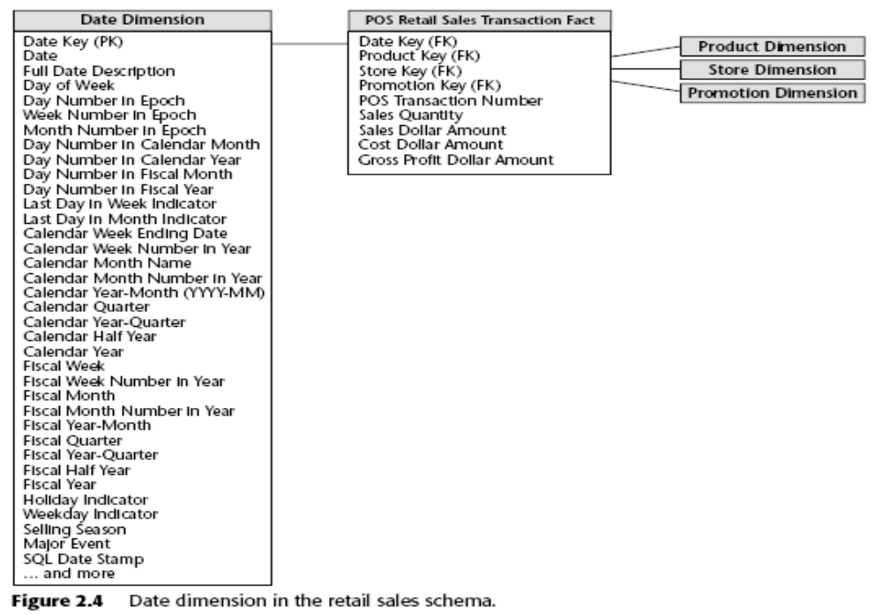
2.3.1 Date Dimension

Slide 11
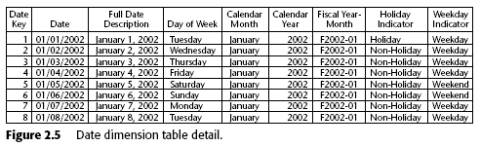
2.3.1 Date Dimension (ct)
Data warehouses always need an explicit date dimension table. There are many date attributes not supported by the SQL date function, including fiscal periods, seasons, holidays, and weekends. Rather than attempting to determine these non-standard calendar calculations in a query, we should look them up in a date dimension table.

Slide 12
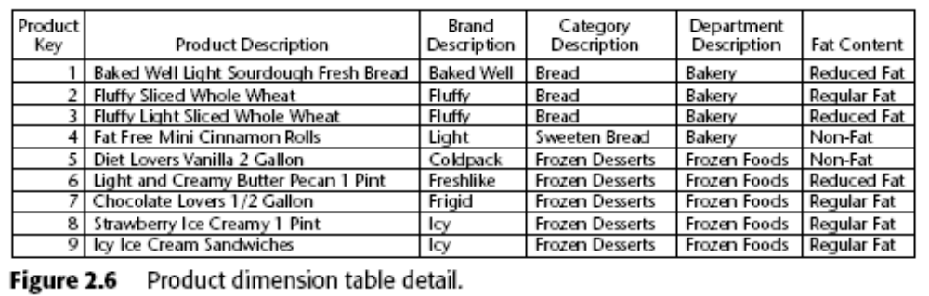
2.3.2 Product Dimension
The dimension table space requirements pale in comparison with fact table space considerations.

Slide 13
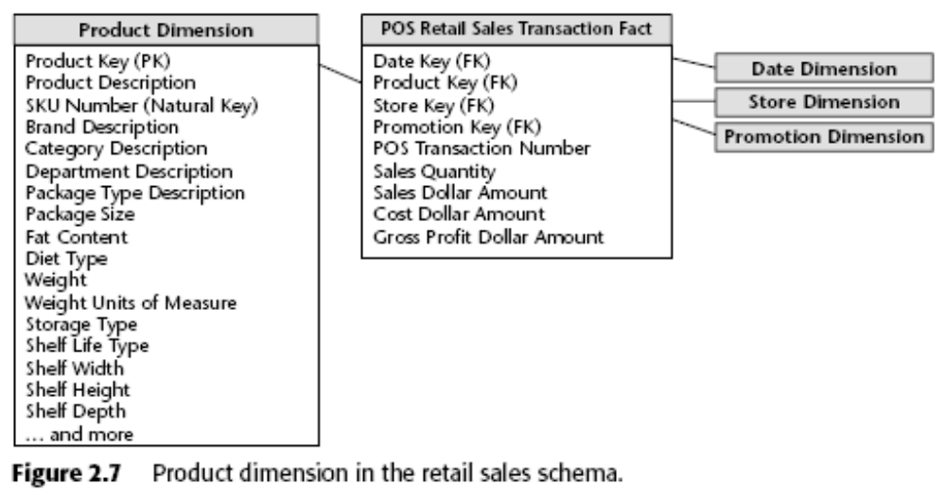
2.3.2 Product Dimension (ct)

Slide 14
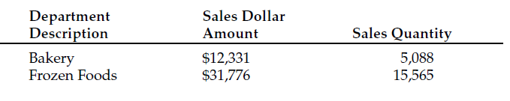
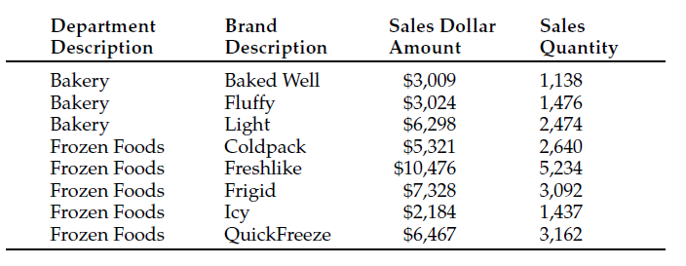
2.3.2 Product Dimension (Drilldown)

Slide 15

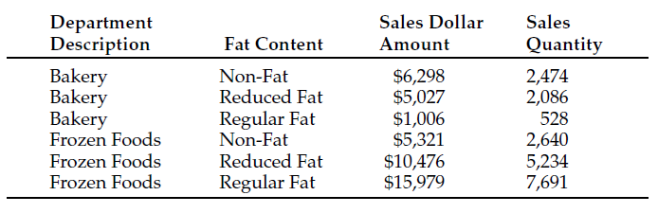
2.3.2 Product Dimension (Drilldown)

Slide 16

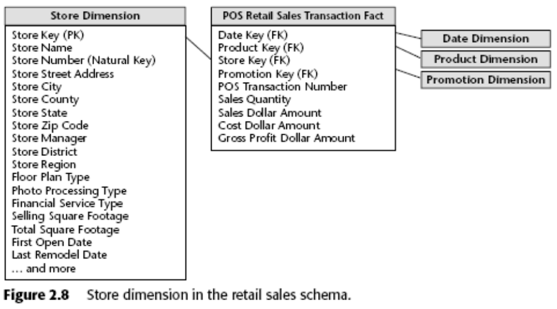
2.3.3 Store Dimension (location)

Slide 17
2.3.4 Promotion Dimension
Product under promotion under has lift ?
Does promotion show a drop in sales prior to or after promotion (time shifting)
Products under promotion showed gain in sales but other products sales decrease (cannibalization)
Promotion show market growth ?
Promotion was profitable ?
Promotion Coverage Factless Fact Table
  What products under promotion did not sell ?
  Fact table only records sold SKUs; therefore, we load at least 1 row for each product on promotion in a store each day (promotion coverage)

Slide 18

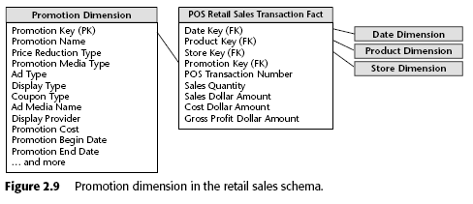
2.3.4 Promotion Dimension

Slide 19
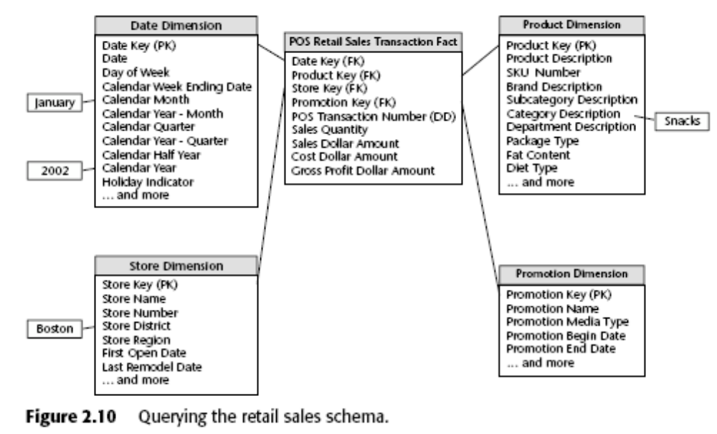
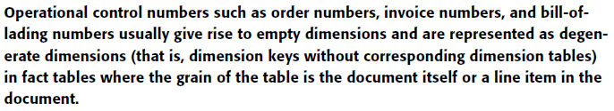
2.3.5 Degenerate Transaction Number Dimension

Slide 20
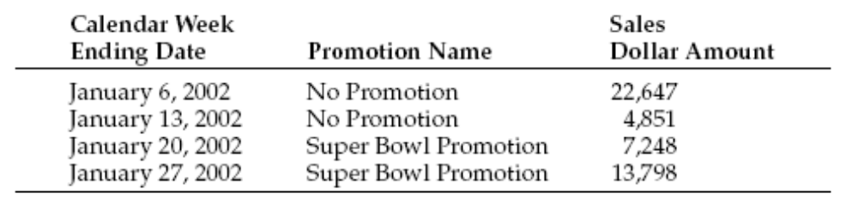
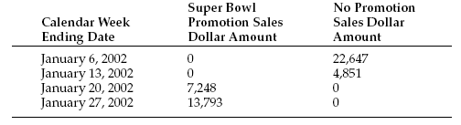
2.4 Retail Schema in Action
If you are using a data access tool with more functionality, the results may appear as a cross-tabular report.

Slide 21
2.4 Retail Schema in Action
Analyzing shopping patterns by geographic, demographic, behavorial …
Embellish our original design with frequent shopper dimension.
  Frequent Shopper Dimension
  Clerk Dimension
  Time of Day
Goals
  Addition of new dimension in fact did not alter the existing dimension keys or facts
  All Pre-existing applications continue to run without unraveling or changing when new dimension attributes, new dim, new measured facts.
  Pre-mature summarization or aggregation would limit our ability to add new dimensions

Slide 22
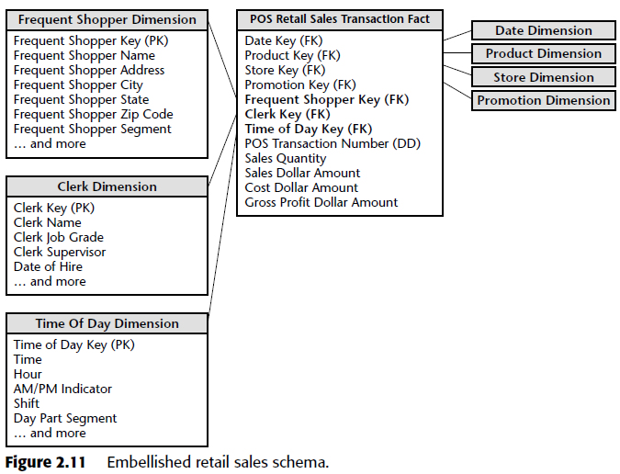
2.5 Retail Schema Extensibility

Slide 23
2.5 Retail Schema Extensibility (ct)
We’ll describe several of these unexpected modification categories, starting with the simplest:
New dimension attributes.
New dimensions.
New measured facts.
Dimension becoming more granular.
Addition of a completely new data source involving existing dimensions as well as unexpected new dimensions.

Slide 24
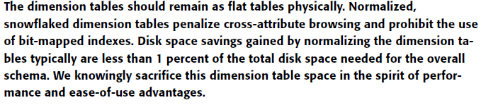
2.6 Resisting Comfort Zone Urges
Dimension Normalization (Snowflaking).
Too Many Dimensions.

Slide 25
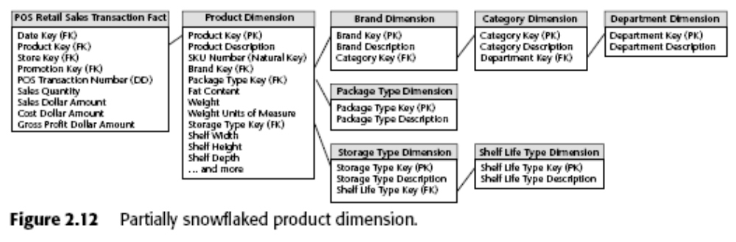
2.6.1 Dimension Normalization (Snowflaking)

Slide 26
2.6.1 Dimension Normalization (Snowflaking) (ct)
The multitude of snowflaked tables makes for a much more complex presentation.
Likewise, database optimizers will struggle with the complexity of the snowflaked schema.
The minor disk space savings associated with snowflaked dimension tables are insignificant.
Snowflaking slows down the users’ ability to browse within a dimension.
Finally, snowflaking defeats the use of bitmap indexes.

Slide 27
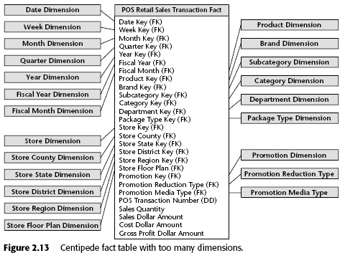
2.6.2 Too Many Dimensions

Slide 28
2.7 Surrogate Keys
Surrogate keys go by many other aliases: meaningless keys, integer keys, non-natural keys, artificial keys, synthetic keys, and so on.
The surrogate keys merely serve to join the dimension tables to the fact table.

Slide 29
2.7 Surrogate Keys (ct)
Modelers sometimes are reluctant to give up their natural keys because they want to navigate the fact table based on the operational code while avoiding a join to the dimension table
Initially, it may be faster to implement a dimensional model using operational codes, but surrogate keys definitely will pay off in the long run

Slide 30
2.7 Surrogate Keys (ct)
One of the primary benefits of surrogate keys is that they buffer the data warehouse environment from operational changes
The surrogate key is as small an integer as possible while ensuring that it will accommodate the future cardinality or maximum number of rows in the dimension comfortably.

Slide 31
2.7 Surrogate Keys (ct)
As we mentioned earlier, surrogate keys are used to record dimension conditions that may not have an operational code, such as the “No Promotion in Effect” condition.
The date dimension is the one dimension where surrogate keys should be assigned in a meaningful, sequential order

Slide 32
2.7 Surrogate Keys (ct)
Finally, surrogate keys are needed to support one of the primary techniques for handling changes to dimension table attributes.
Of course, some effort is required to assign and administer surrogate keys, but it’s not nearly as intimidating as many people imagine.

Slide 33
2.7 Surrogate Keys (ct)
A surrogate key is necessary if the transaction control numbers are not unique across locations or get reused.
Your transaction control number may be a bulky 24-byte alphanumeric column. In such cases, it would be advantageous to use a surrogate key

Slide 34
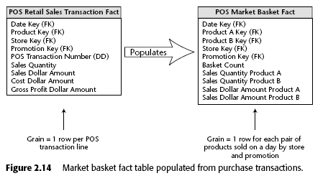
2.8 Market Basket Analysis

Slide 35
Summary
We got our first exposure to designing a dimensional model.
We strongly encourage the four-step process for tackling dimensional model designs.
Loading the fact table with atomic data provides the greatest flexibility because we can summarize that data “every which way.”

